Slide 1
CMP3103M – Robotics Assessment
Graeme Hutchison
14470469

Slide 2
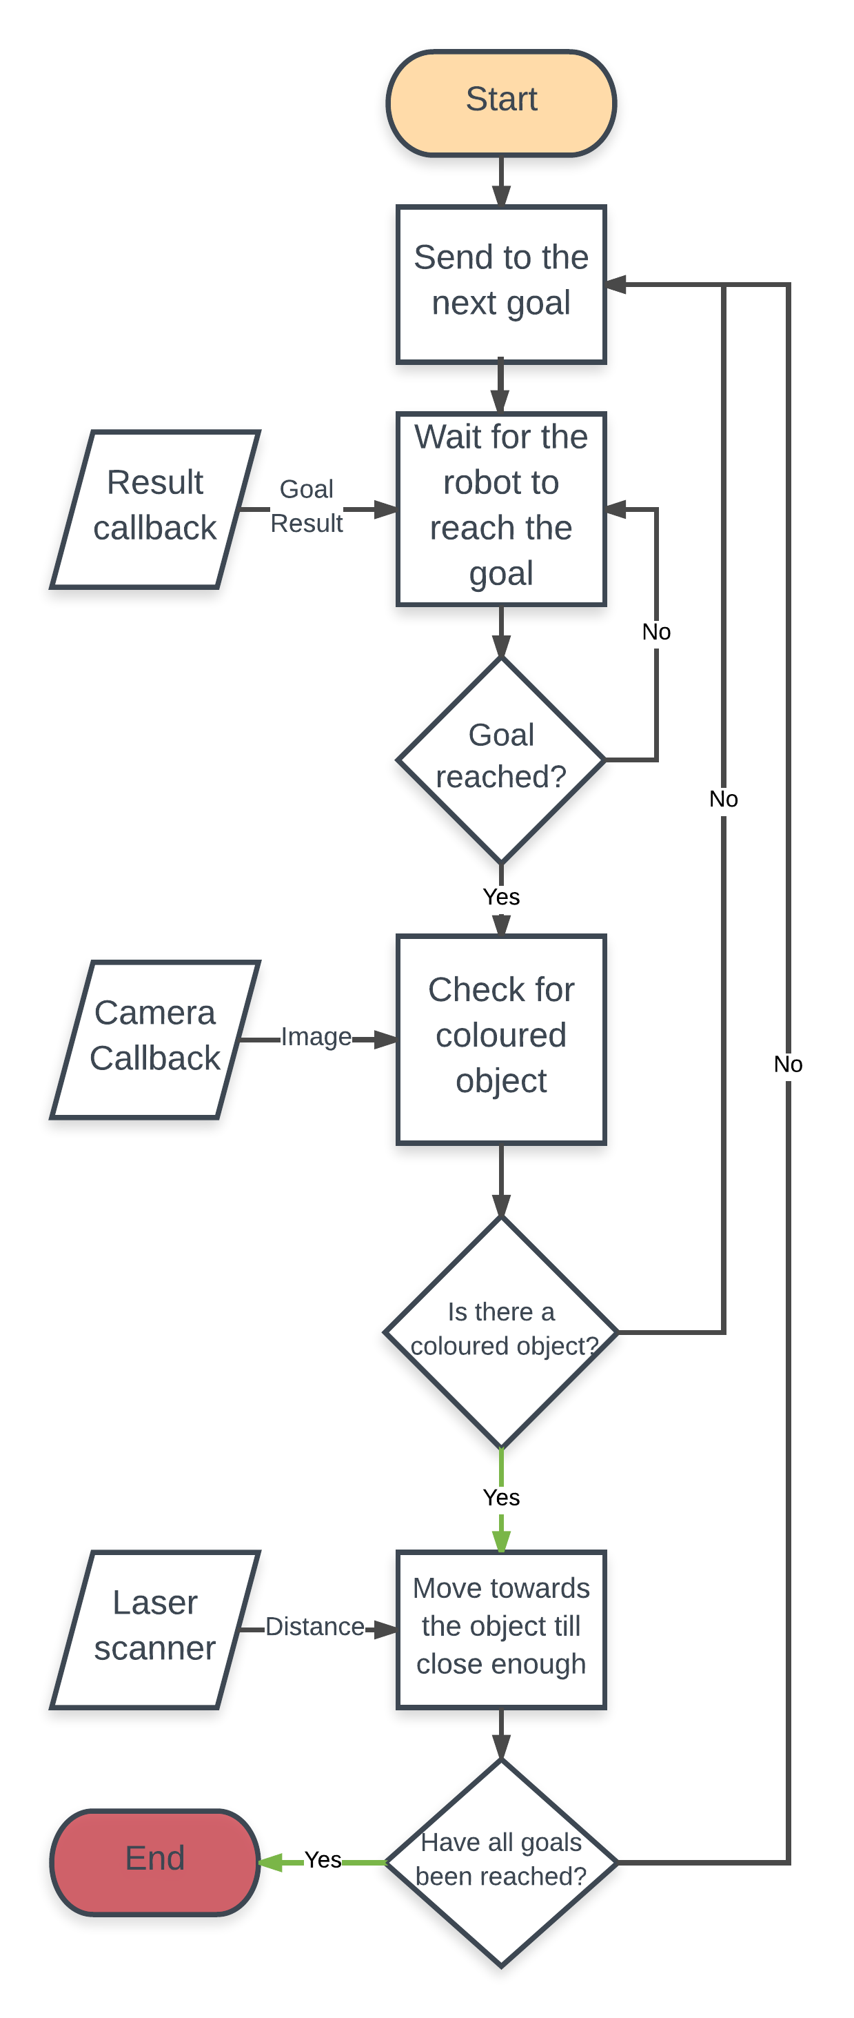
System Architecture and Features

Slide 3
